Slide 1

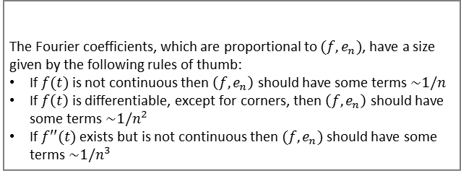
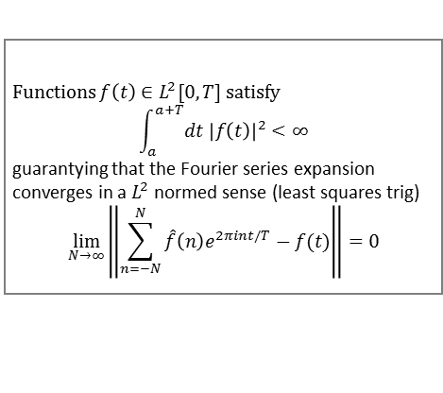
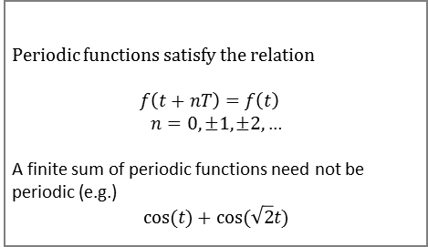
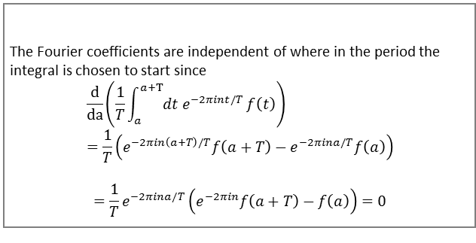
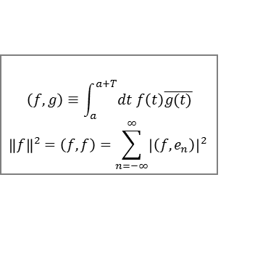
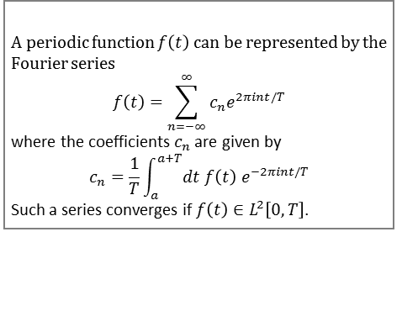
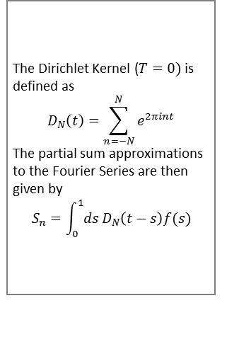
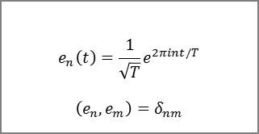
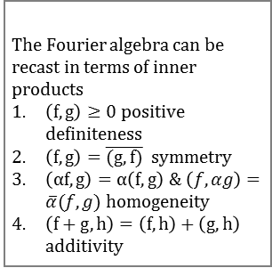

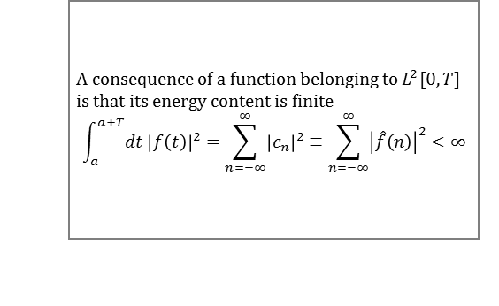
Chapter 1: Fourier Series
Periodic Functions with Period $T$[4-5]
Fourier Series of Periodic Functions [15]
Periodic functions satisfy the relation
$$f\left(t+nT\right)=f\left(t\right)$$
$$n=0,±1,±2,…$$
A finite sum of periodic functions need not be periodic (e.g.)
$$\cos{(t)}+cos⁡(\sqrt{2}t)$$
A periodic function $f\left(t\right)$ can be represented by the Fourier series
$$f\left(t\right)=\sum_{n=−∞}^{∞}{c_{n}e^{2πint/T}}$$
where the coefficients $c_{n}$ are given by
$$c_{n}=\frac{1}{T}\int_{a}^{a+T}{dt f\left(t\right) e^{−2πint/T}}$$
Such a series converges if $f\left(t\right)∈L^{2}\left[0,T\right]$.
$L^{2}\left[0,T\right]$ Integrable Functions [6]
Energy Content [6,32]
Functions $f\left(t\right)∈L^{2}[0,T]$ satisfy
$$\int_{a}^{a+T}{dt {\left|f\left(t\right)\right|}^{2}<∞}$$
guarantying that the Fourier series expansion converges in a $L^{2}$ normed sense (least squares trig)
$$\lim_{N→∞}\left\|\sum_{n=−N}^{N}{\hat{f}\left(n\right)e^{2πint/T}}−f(t)\right\|=0$$
A consequence of a function belonging to $L^{2}[0,T]$ is that its energy content is finite
$$\int_{a}^{a+T}{dt {\left|f\left(t\right)\right|}^{2}}=\sum_{n=−∞}^{∞}{{\left|c_{n}\right|}^{2}}≡\sum_{n=−∞}^{∞}{{\left|\hat{f}\left(n\right)\right|}^{2}}<∞$$
Fourier Coefficients [12]
Inner Product Algebra
[28-9]
The Fourier coefficients are independent of where in the period the integral is chosen to start since
$$\frac{d}{da}\left(\frac{1}{T}\int_{a}^{a+T}{dt e^{−2πint/T}}f\left(t\right)\right)=\frac{1}{T}\left(e^{−2πin\left(a+T\right)/T}f\left(a+T\right)−e^{−2πina/T}f\left(a\right)\right)$$
$$=\frac{1}{T}e^{−2πina/T}\left(e^{−2πin}f\left(a+T\right)−f\left(a\right)\right)=0$$
The Fourier algebra can be recast in terms of inner products
$\left(f,g\right)≥0$ positive definiteness
$\left(f,g\right)=\overline{(g,f)}$ symmetry
$\left(αf,g\right)=α\left(f,g\right)$ & $\left(f,αg\right)=\overline{α}(f,g)$ homogeneity
$\left(f+g,h\right)=\left(f,h\right)+\left(g,h\right)$ additivity
Inner Product Definition [30,32-3]
Orthonormal Basis Vectors [32]
Dirichlet Kernel [59]
$$\left(f,g\right)≡\int_{a}^{a+T}{dt f\left(t\right)\overline{g(t)}}$$
$${\left\|f\right\|}^{2}=\left(f,f\right)=\sum_{n=−∞}^{∞}{{\left|\left(f,e_{n}\right)\right|}^{2} }$$
$$e_{n}\left(t\right)=\frac{1}{\sqrt{T}}e^{2πint/T}$$
$$\left(e_{n},e_{m}\right)=δ_{nm}$$
The Dirichlet Kernel ($T=0)$is defined as
$$D_{N}\left(t\right)=\sum_{n=−N}^{N}{e^{2πint}}$$
The partial sum approximations to the Fourier Series are then given by
$$S_{n}=\int_{0}^{1}{ds}D_{N}\left(t−s\right)f(s)$$
Size of Fourier Coefficients [52]
The Fourier coefficients, which are proportional to $(f,e_{n})$, have a size given by the following rules of thumb:
If $f(t)$ is not continuous then $\left(f,e_{n}\right)$ should have some terms $\sim 1/n$
If $f\left(t\right)$ is differentiable, except for corners, then $\left(f,e_{n}\right)$ should have some terms $\sim 1/n^{2}$
If $f′′(t)$ exists but is not continuous then $(f,e_{n})$ should have some terms $\sim 1/n^{3}$

